Slide 1
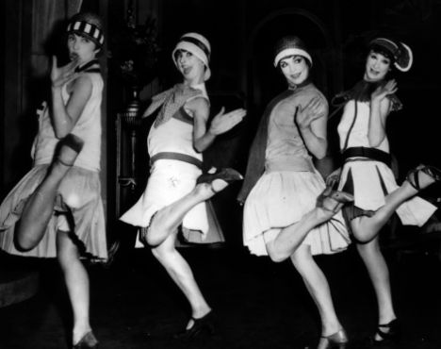
The Roaring Twenties
How was the social and economic life different in the early twentieth century from that of the late nineteenth century?
How has the cultural identity of the US changed over time?

Slide 2
“This is a story of America between two Wars, told in terms of the most significant, or typical, or utterly fantastic new events of the gaudy and chaotic years that separated Versailles from Pearl Harbor. . . We seem to have fluctuated between headaches: sometimes induced by prohibition, more frequently by the fevered pace of time. During these throbbing years we searched in vain for a cure-all, coming no closer to it than the aspirin bottle; hence: The Aspirin Age. . . Twenty-two prominent authors, all closely connected with the period have written . . . [what] is, I hope, no mere chronicling of the arresting events, but rather a recreation of a strange and almost somnambulistic time when America was much younger in spirit than it ever can be again.”
-Isabel Leighton

Slide 3
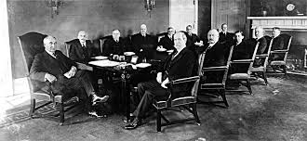
Politics of the 1920s
LEQs:
How was Harding’s effort to return to “normalcy” prevented by political scandals?
What government policies helped the economy recover from the postwar recession?
Describe U.S. efforts to avoid future wars.

Slide 4
A better world?
Success
19th Amendment, trust busting, child labor laws
BUT . . .
Disillusionment
Economic problems, labor unrest, racial tension, antiradicalism

Slide 5
Failure of Progressivism
“It is only once in a generation that a people can be lifted above material things. That is why conservative government is in the saddle two-thirds of the time.” -Wilson
Do better laws make better lives?
WWI- US turns to isolationism
Red Scare
16th Amend. fails to redistribute wealth
Farmers, workers
19th Amend. → few changes in politics
18th Amend. to save families→ openly disregarded

Slide 6
1920 Election
Issues over disillusionment, recession, peace treaty/LON
fear of radicals, terrorists, l
Labor unrest
Workers, farmers
Dem. James Cox vs. Rep. Warren G. Harding
Last election campaign by phonograph

Slide 7
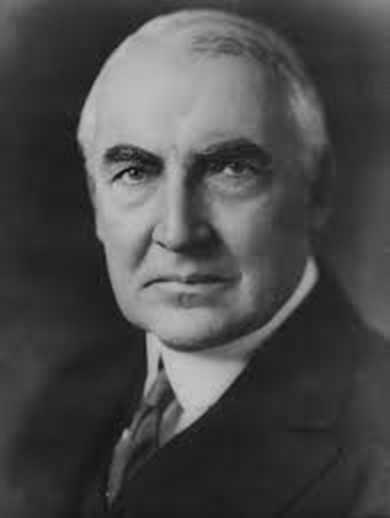
1921-1923: Warren G. Harding
A return to normalcy

Slide 8
Harding
“America’s present need is not heroics, but healing; not nostrums, but normalcy; not revolution, but restoration; not agitation, but adjustment; not surgery, but serenity; not the dramatic, but the dispassionate; not experiment, but equipoise; not submergence in internationality, but sustainment in triumphant nationality.” -WGH

Slide 9
On Progressivism
Americans “were tired of issues, sick at heart of ideals, and weary of being noble.”
- William Allen White, progressive journalist

Slide 10
Presidential Focus
Return to normalcy
Pre-Progressive Era
Gov. out of business
Opposition to social programs of Progressives
Reject LON

Slide 11
Notable Issues
Red Scare (1919-1921)
Sacco-Vanzetti Trial
Labor Unrest
4 strikes
Immigration restriction
Budget and Acct. Act (1921)
Annual budget
Dawes Plan (1924)
Stabilize Weimar economy ($2.5 billion)
England/France debt issue

Slide 12
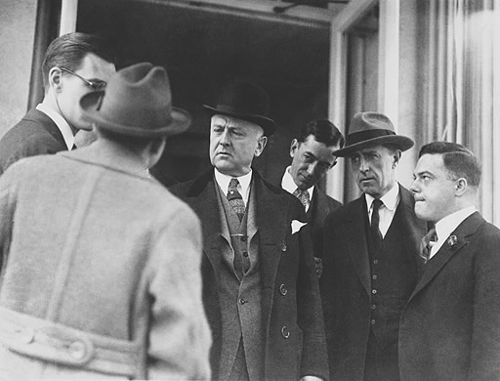
The Ohio Gang: Grant Redux
Harry M. Daugherty- Att.Gen. (crook)
Albert Fall- SOI (prison)
Andrew Mellon- SOT*
Charles Evans Hughes- SOS*
Herbert Hoover- SOC*
Henry Wallace- AG
Taft → SC Justice

Slide 13
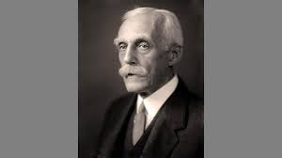
Taxes and Tariffs
Mellon Plan = effort to lower income taxes
60%→50%→ 25%→20%
Wealth with few = capital investment
4%→ 3%
Fordney-McCumber Tariff (1922)
Chemical/metal products, farm goods
Gov. spending cuts
Nat’l debt lowered
BALANCED BUDGET

Slide 14
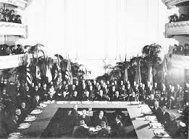
Disarmament: 11/21-2/22
WGH- Desire to reduce army, isolate US from others
1921- Washington Naval Conference
Hughes- SOS, in DC
4, 5, 9 Power Treaty
DISARMAMENT
Japan, GB, US
Pacific Peace
Cryptography
Battleships lost
1928- Kellogg-Briand Pact
NO USE OF WAR!

Slide 15
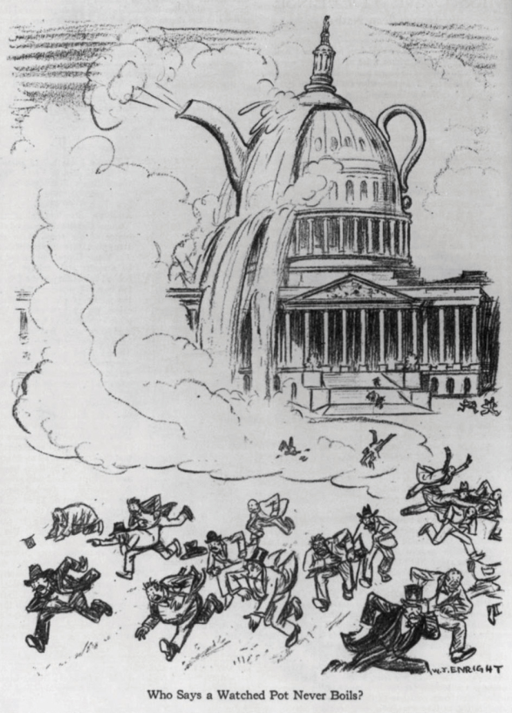
SCANDAL!
Teapot Dome (1923)
= Watergate = corruption
Others:
Charles Forbes- Vet. Bur.
Daughtery- Att.Gen.
Prohibition bureau
“I have no trouble with my enemies, I can take care of my enemies all right. But my damn friends. . . they’re the ones that keep me walking the floors at night!” - WGH

Slide 16
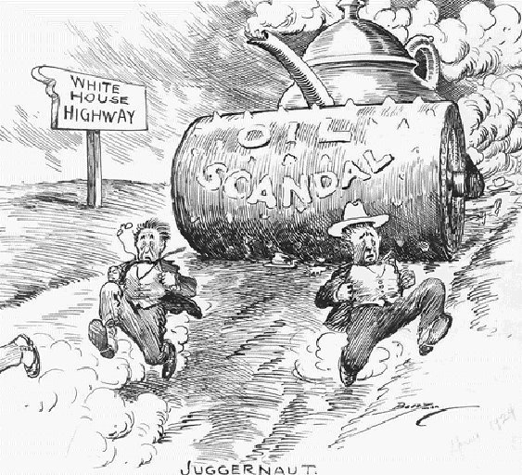

Slide 17
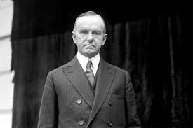
“Silent Cal”
1923-1928

Slide 18
A New Old Style
Image of traditional roots, solid integrity
Revert to GA form: passive Pres., leadership in Congress
He “aspired to become the least President the country had ever had. . .”

Slide 19
The Business of America is Business
Focus on industrial development
At expense of labor & AG
Unleash free enterprise
End gov. regulation
Reduce taxes
“Never before. . . Has a government been so completely fused with business.” -WSJ

Slide 20
“After all, the chief business of the American people is business. They are profoundly concerned with producing, buying, selling, investing and prospering in the world. I am strongly of the opinion that the great majority of people will always find these the moving impulses of our life.”

Slide 21
HOWEVER. . .
“Of course, the accumulation of wealth cannot be justified as the chief end of existence,” he said. “But we are compelled to recognize it as a means to well-nigh every desirable achievement. So long as wealth is made the means and not the end, we need not greatly fear it...But it calls for additional effort to avoid even the appearance of the evil of selfishness. In every worthy profession, of course, there will always be a minority who will appeal to the baser instinct. There always have been, probably always will be, some who will feel that their own temporary interest may be furthered by betraying the interest of others.”

Slide 22
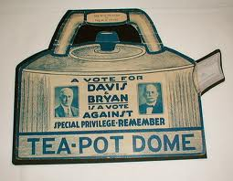
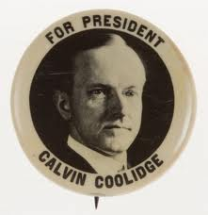
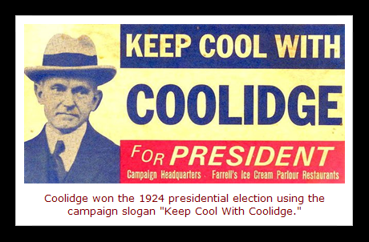
1924 Election: Keep Cool with Coolidge
Repub. Coolidge v. Dem. John Davis
Prosperity, party split, Harding scandals
Robert La Follette (R) for Progressives
“I am a member of no organized political party. I am a Democrat.” - Will Rogers
New urban culture vs. tradition

Slide 23
A Surging Prosperity
New consumer goods
For general public
Handheld cameras, watches, washing machines, cigarette lighters, vacuum cleaners
End of Protestant ethic of “plain living”
New goods + middle class saving/spending = havoc
Americans “first importance to his country is no longer that of citizen but that of consumer. Consumption is a new necessity.”

Slide 24
Agriculture Suffers
War boom into 1920 → demand down → prices drop
1926- foreclosure, bank failures in South
Farms more mechanized → better crop yields, fertilizers, animal breeder → farmers as businessmen
Recession → co-ops
Effort to bring order, crop contracts, uniform standards
McNary-Haugen Act (1927)
Farm surplus issue
Political unity of S & W

Slide 25
Labor Issues
Suffer from radical stereotype, open shops
Harding- advocated for collective bargaining, work day reduction
“Yellow-dog” contracts
No union membership
“Welfare capitalism”
Profit sharing, bonuses, pensions, health programs
Gastonia Strike (Loray mill, NC)
Textile strikes, mills close (demobilization), wages cut, new tech. → United Textile Works (AFL)/NTWU → suppression of unions → violence → Nat’l Guard

Slide 26
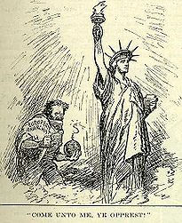
The Red Scare

Slide 27
Fear Spreads
Fear of radicalism
Bolshevik Rev. → Soviet Union (1921) → collectivization
Loss of property
Comintern = org. to spread Comm. Revs around world

Slide 28
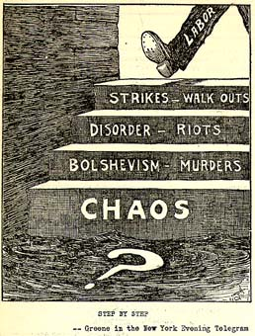
June 2, 1919- 8 bombs mailed to U.S. leaders
Terrorism? Sign of revolution?
Boston, NY, DC (Palmer), Pitt., Phil., E. Orange, Newton, Patterson
Earlier April bombs
Wall Street
Unions = radicalism & terrorists
Ex: Debs

Slide 29
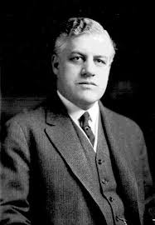
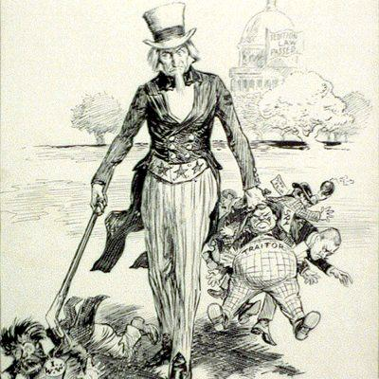
The Palmer Raids
What’s the fix?
“The Fighting Quaker”
11/1919-1/1920: RAID!
Why support?
Raid homes and offices without warrant
Deportations- the “Soviet Ark”
Jailed w/o evidence or attorney
No court hearing
Centralia, WA issue
May Day Dupe = END of Palmer Raids
Palmer loses support

Slide 30
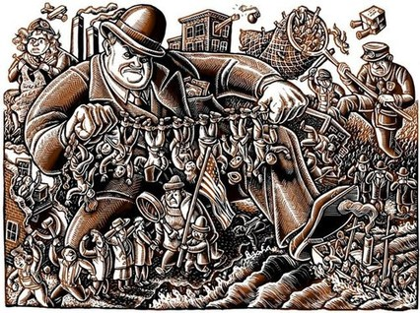

Slide 31
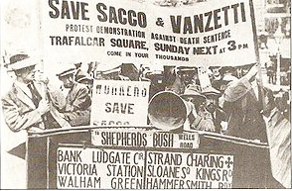
Sacco and Vanzetti
Radicals! Anarchists! Immigrants! Wobblies!
Charged w/ murder of paymaster & guard @ shoe factory in South Braintree, MA
Executed

Slide 32
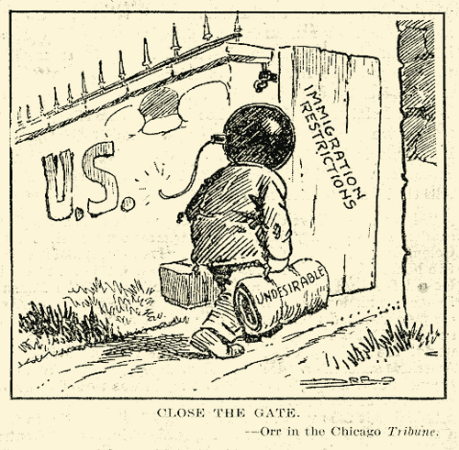
Fear of Immigrants

Slide 33
Immigration restrictions
Why?
Slow pop. growth, protect US from radicals
Xenophobia
Right vs. Wrong immigrants (Prescott Hall)
Radicals (Conserv.), block voting (politicians), overcrowded cities (reformers)

Slide 34
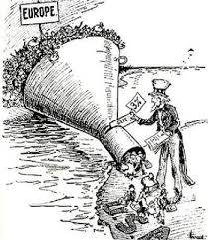
The Quota system: “America for Americans” -Coolidge
How?
Literacy Test
Laws
Emergency Quota Act- 1921
3%, 1910
Immigration Act of 1924
2% 1890
National Origin Act- 1929
150k total

Slide 35
Effect
Purpose to tilt balance to old immigrant nations
Exclusion of people from East Asia
Gate still open to W. Hemisphere
Increase in Hispanic Catholic population
Mexicans, Puerto Ricans, Cubans

Slide 36
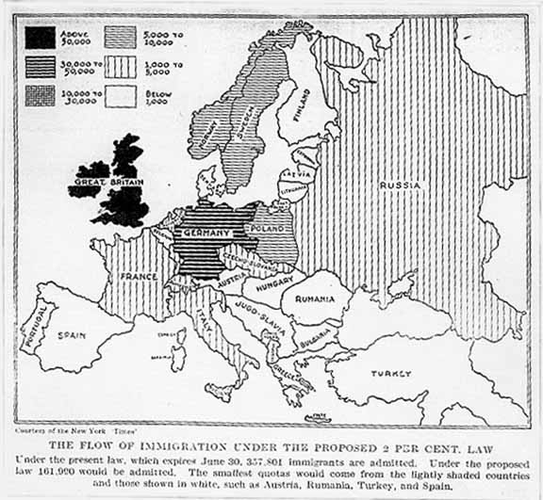

Slide 37
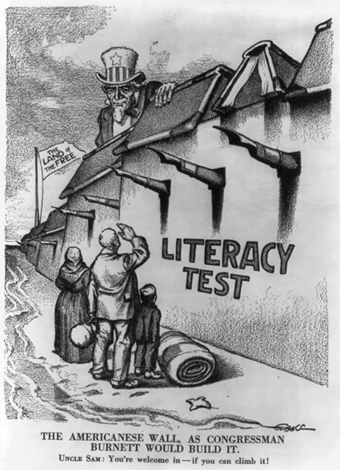

Slide 38
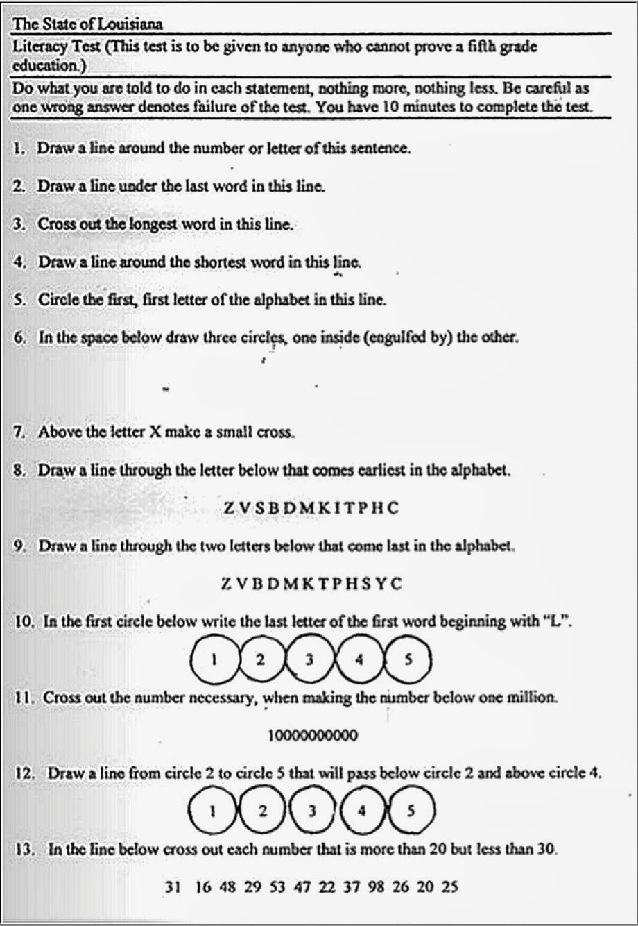

Slide 39
Germany | 51, 227 | Poland | 5, 982 | Africa | 1, 100
GB | 34,007 | Italy | 3, 875 | Armenia | 124
Ireland | 28,567 | Czech. | 3, 073 | Australia | 121
Sweden | 9, 561 | Russia | 2, 248 | Palestine | 100
Norway | 6, 453 | Yugo. | 671 | Syria | 100
France | 3, 954 | Romania | 603 | Turkey | 100
Denmark | 2, 789 | Portugal | 503 | Egypt | 100
Switz. | 2, 081 | Hungary | 473 | NZ | 100
Nether. | 1, 648 | Lith. | 344 | Other | 1, 900
Austria | 785 | Latv. | 142
Other | 1, 411 | Other | 555
TOTAL | 142, 483 |  | 18, 439 |  | 3, 745
 | 86.5% |  | 11.2% |  | 2.3%
http://historymatters.gmu.edu/d/5078/

Slide 40
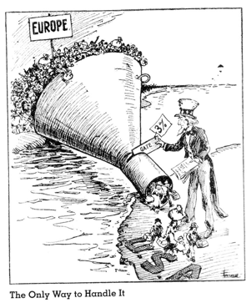

Slide 41
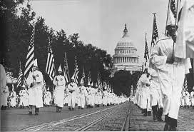
The Rise of the New Klan

Slide 42
100% Americanism
WASP nativists
vs. African-Americans, Catholics, Jewish population, immigrants, “demon rum”, saloons
Use terror, assault
→ further spread
Response to
Shifting morals, decline in influence of church, social permissiveness, city life
Defend Traditional America- God and country!

Slide 43
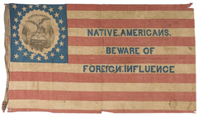

Slide 45
Teapot Dome Scandal: U.S. gov. set aside oil-rich public land to be used by U.S. Navy in Teapot Dome, WY and Elk Hills, CA. Albert B. Fall (Sec. of Interior and close friend of oil executives) got oil reserves transferred from Navy to the Dept. of the Interior. Then, Fall leased the land secretly to two private oil companies and received more than $400,000 in “loans, bonds, and cash.” Fall was found guilty of bribery and became 1st American to be guilty of a felony while holding a cabinet post.
Charles R. Forbes (head of Veterans Bureau)- illegally sold government & hospital supplies to private companies
Colonel Thomas W. Miller (head of Office of Alien Property) caught in bribery.
Calvin Coolidge (VP under Harding) helped restore faith in gov. through his presidency.

Slide 46
Postwar Issues and Fears
After war, Americans exhausted. Economy must adjust from wartime production back to consumerism. Cost of living had doubled during war. Returning soldiers face unemployment or took old jobs back from women/minorities. Farmers and factory workers suffer as wartime orders decrease.
FEARS:
Nativism (prejudice against foreign-born people) spreads as people fear outsiders. A threat to American way of life.
Leads to belief in isolationism (policy of pulling away from involvement in world affairs).

Slide 47
FEARS, con.:
Another threat was communism- economic & political system based on a single-party government ruled by a dictatorship. Goal was to equalize wealth and power, remove private property in order for government ownership of RR, factories, other businesses.
The Red Scare: 1919 brought panic to U.S. after Russian revolution. Vladimir Lenin and followers (Bolsheviks, “Reds”) create new Communist state and hope to see a worldwide revolution to abolish capitalism (private ownership, profit). American Communist Party is formed and nearly 70,000 join. Bombs sent to gov. and business leaders, causing public to be fearful the Communists were taking over.

Slide 48
The Palmer Raids: August, 1919- U.S. Attorney General A. Mitchell Palmer & J. Edgar Hoover (assistant) hunt down suspected Communists, socialists (common ownership/control of economy, social equality, distribution of wealth based on contributions), and anarchists (people who oppose any form of government). Would raid people’s homes, ignore civil rights, jail suspects w/out legal counsel. Many foreigners deported. No evidence of revolution or explosives found during raids. Palmer lost support of public.

Slide 49
Limiting Immigration
“Keep America for the Americans”- Nativists want to limit immigrants entering US. Anti-communist and nativist feelings motivate groups to harass any unlike themselves.
KKK = “100% Americanism” → white male persons, native-born gentile citizens. Also want to keep blacks “in their place,” work to destroy saloons, opposed unions, wanted to rid U.S. of Catholics, Jews, and foreign-born people.
Emergency Quota Act: 1921, Congress set up system for establishing maximum # of people who could enter U.S. from each foreign country. Goal was to cut immigration into the U.S. Percentages show discrimination against people from E and S Europe (Jews, Roman Catholics). Japanese immigration halted. Quota did not apply to other Western Hemisphere nations (Canada, Mexico).

Slide 50
Ch. 12, Sec. 3 The Business of America
What was the impact of the automobile in the 1920s?
How did new conveniences and new ways to pay for them make the economy less stable?
How did the boom of the 1920s effect growth in Florida?

Slide 51
American Business Flourishes
Calvin Coolidge (1923-1929) was a respected man of integrity when he took over the presidency following Harding’s death in 1923. Coolidge fit into the booming, pro-business spirit of the 1920s. He favored legislation that kept taxes down and business profits up & policies that gave businesses available credit to expand. Goal was to keep government interference in business at a minimum so private enterprise could flourish.

Slide 52
Coolidge administration kept tariffs on imports high to protect American business.
U.S. wages were rising, new technology was introduced, and saw increase in productivity.

Slide 53
The Automobile and the Airplane
Henry Ford began assembling Model Ts from 1908 until 1927. Ford transitioned from the Model T to the Model A, a more luxurious car available in multiple colors.
Effects of auto: Visible effect was necessity of paved roads. Route 66 developed for people traveling west from Chicago to California. Many settled in towns along the way. Gas stations popped up, motels, tourist stops, shopping centers. Stop lights, tunnels, intersections followed.

Slide 54
Car liberated isolated rural families. Could now travel to shop, do business, for entertainment, vacation. More independence for women/young people through increased mobility. Workers could live away from jobs. Cars became a status symbol for families and to the world.
Many cities began to develop economic base in the auto industry. Akron (OH), Detroit, Flint (MI).
Auto industry symbolized success of free enterprise system and the “Coolidge Era.” No where else in world could someone with little money own their own car. ($385 -$1400)

Slide 55
Airplanes began as mail-carrying service for USPS. Equipment developed for weather forecasting, use of radios/navigation tools help increase flights for commerce and travel. By 1927, transatlantic flights were possible and cargo & commercial flights begin.
Charles Lindbergh, Amelia Earhart make transatlantic flights
Lockheed Company (the Vera model) to transport in 1920s
Pan American Airways becomes 1st transatlantic passenger flights

Slide 56
American Prosperity
America experiences much wealth in 1920s. Avg. annual income rose from $522 to $705. Changes the way Americans live.
Gas powered much of the economic boom in 20s (autos, planes), but so did electricity. Factories began to use electricity, households and rural areas were able to get electricity. Saw electric irons, electric refrigerators ($$), ranges, toasters. Lives made easier for housewives, which freed up time for other activities in community or for leisure- coincides w/ women getting jobs outside house.

Slide 57
New goods bring new marketing- ads inform public about product, price, desire for youthfulness, beauty, health, wealth. Brand names flourished and what used to be “luxuries” became necessities.
“Say it with flowers” -Florist industry
“Reach for a Lucky instead of a sweet” –Cigarettes
Listerine- from luxury to necessity (no bad breath!)
Image of businessman idolized. Seen as a dreamer with an imagination seeking new ways to help humanity. They are a builder and doer of great things. Growth of Rotary, Kiwanis, Lions club allows men to meet for lunch and serve communities.

Slide 58
Ch. 13: Conflict between traditional attitudes and modern ways of thinking
How was city life different than small town life?
Evaluate the ways Prohibition was a success or a failure.

Slide 59
In 1920s, migration to cities from rural towns and farms accelerated
The Urban Scene
Small Town America
Cities were industrial powerhouses
High population
Included whites, blacks, immigrants- varied cultures
Cars, buses, trolleys moved people around
Activities: movies, vaudeville, clubs, gambling, drinking, casual dating
People discussed & argued social and scientific ideas- tolerance of other ideas and values
Fast-paced life, impersonal, strangers
Had to have endurance to survive!
New York, Chicago, Philadelphia
Rural towns, farming communities
People bound together by conservative morals, religion, friends, family
Perspectives often the same
Slow-paced life, intimate relationships
Judgment often on background, not accomplishment

Slide 60
The Prohibition Experiment (1920-1933)
Social reformers work to ban alcohol and the evils associated with it. Alcohol seen as primary cause of crime, abuse, accidents, & corruption of American morals and society.
January, 1920: 18th Amendment bans the manufacture, sale, and transportation of alcohol (but not the drinking of)
Some early success as saloons close, arrests for drunkenness decrease. BUT Americans tired of sacrificing and wanted to enjoy life and do as they wanted & immigrants did not consider alcohol a sin. This leads to underground business of manufacture, sale, and distribution of alcohol.

Slide 61
Speakeasies established as hidden saloons/nightclubs where drinkers could socialize. Used secret cards or passwords to get it and had to speak “easy” (quietly) while inside so wouldn’t get caught.

Slide 62
The Prohibition Experiment
Americans also begin to distill own alcohol (moonshine) by building secret/hidden stills. Bootleggers & Rumrunners would smuggle in alcohol from Canada, Cuba, W. Indies. Souped-up cars emerged to helped transport alcohol.
Death rate from alcohol decreases, alcohol-related crime dropped. Death, paralysis, blindness increased from adulterated alcohol use.
Prohibition could not be enforced. There was not enough budgeted money or people to do everything necessary: patrol coastlines & borders, track down stills, monitor roads.

Slide 63
Prohibition led to a disrespect for the law and law enforcement. Many tried to get around the law and those who didn’t were aware of corruption in police forces (bribes, pay-offs).
Also, prohibition contributed to organized crime in major cities. Criminal groups organized themselves around the illegal liquor and bootlegging business. People saw prohibition as a law against a victimless crime, so Americans turned to gangsters to supply them alcohol & in return provided gangs with a steady income. Because of large profits, rivalries between gangs sprang up and REAL crimes occurred.
Al Capone, Chicago ($60 million/year)

Slide 64
Ch. 13, Sec. 2

Slide 65
The Twenties Woman
A new world opens up for women: new attitudes, new values, new dress, new independence!
Dresses are UP, bobs are IN, stockings, beads, pumps
Women become ASSERTIVE- smoke, drink, dance, & talk about sex without ruining their reputation
Marriage based on love/companionship/equal partnership
The Flapper- emancipated young woman who embraced new fashions & urban attitudes of the day.

Slide 66
Work: Opportunities open for college graduates as teachers, nurses, librarians. Big businesses need clerical workers. Stores need clerks, factories/industries need assembly line workers. 10 million women working by 1930- but deal with inequality/discrimination in position & pay.

Slide 67
Home/Family: Conveniences of the time (stores, public agencies to deal with elderly, public health clinic) give women freedom from traditional family responsibility. Birth control widely available, so see birthrate decline during 20s. Children free to go to school & play (versus working). Strain on parents was to deal with teenagers- exposed to new ideas, less time spent w/ family, peer pressure intensified.

Slide 68
Ch. 13, Sec. 3

Slide 69
Pop Culture in the 1920s
As education becomes widespread, literacy in America increases. Newspaper circulations rose and editors sensationalized headlines to attract business. Magazines are founded (Reader’s Digest, Time) to summarize the week’s news.
Radio emerged as most powerful mass communication medium. Listeners could hear news, music/entertainment/sports, and advertisements. News broadcasted AS IT HAPPENED.
1920s were prosperous & Americans had extra time and extra money to spend on entertainment.
Crossword puzzles, mahjong, dance marathons, baseball, tennis

Slide 70
Movies became popular as people seek an escape from life through romance and comedy. Playwrights and composers break away from European traditions and form new AMERICAN sounds (jazz) & ideas (isolationism, family conflict). Painters appeal to realities and dreams of American life.
Movies: The Jazz Singer (1927- 1st with sound), Steamboat Willie (1928- Walt Disney’s 1st animated picture with sound)
Composer: George Gershwin
Painter: Georgia O’Keefe (intense colors)

Slide 71
New authors emerge in one of richest eras in literary history.
F. Scott Fitzgerald: coined “Jazz Age,” revealed negative side of gaiety & freedom, of the wealthy living imperiled lives in gilded surroundings. The Great Gatsby, This Side of Paradise
Edith Wharton: clash of traditional vs. modern values
Ernest Hemingway: Wounded in WWI, criticized glorification of war. A Farewell to Arms, The Sun Also Rises

Slide 72
Ch. 13, Sec. 4

Slide 73
Harlem Renaissance: “Black is Beautiful”
NAACP(1909) continued to work to protect African-American civil rights, anti-lynching laws, & protest racial violence.
Marcus Garvey (Jamaican immigrant) wanted to see African-Americans build a separate society from whites. Founded Universal Negro Improvement Assoc. that promoted African-American businesses and encouraged blacks to return to Africa and build a mighty nation. Later in 1920s, sent to jail for mail fraud- movement slows, but legacy of black pride lives on.

Slide 74
Harlem located on Manhattan Island in New York. Was neighborhood with world’s largest black community (South, W. Indies, Cuba, PR, Haiti). Harlem Renaissance was literary and artistic movement celebrating African-American culture.
Movement led by well-educated, middle-class African-Americans. Celebrated heritage, wrote defiantly about trials of being black in a white world.

Slide 75
Claude McKay- novelist, poet: urged blacks to resist prejudice, expressed pain of life in black ghettos
Langston Hughes- poet: described difficult lives of working –class blacks, many poems move to jazz/blues tempos
Zora Neale Hurston- author: folktales, reminded blacks of richness of their heritage

Slide 76
All That Jazz
Jazz born in New Orleans by blending ragtime and vocal blues. 1918- taken north to Chicago by Joe “King” Oliver and his Creole Jazz Band. Louis Armstrong joined and rocketed to stardom. Armstrong made personal expression an essential part of jazz.
Jazz spread to New York, Kansas City, and Memphis. Was most popular music for dancing (whites and blacks) and could be heard all over Harlem (Cotton Club).
Others to note: Edward Kennedy “Duke” Ellington, Cab Calloway, Bessie Smith
Cab Calloway and Louis Armstrong popularized “scat-” improvised jazz singing using sounds instead of words

Slide 77
Characteristics of the 1920s
Economic prosperity
New ideas
Changing values
Personal freedom
Traditional attitudes vs. modern way of thinking
Important developments in art, literature, music

