Slide 1
The Progressive era
Reforms address problems and question the government and American society

Slide 2
Origins of Progressivism
Progressive movement aimed to restore economic opportunities and correct injustices in American life.
Middle-class reformers address many problems such as unsafe working conditions, dominant role of corporations, making government responsive to people.

Slide 3
Four goals:
Protecting social welfare- help and services for poor. YMCA activities, education, community centers, social services.
Promoting moral improvement- improvement in personal behavior and morals. Prohibition (ban of alcohol) and the Woman’s Christian Temperance Union (WCTU). Sponsor schools, visit inmates, work for suffrage.
Creating economic reform- Muckrakers expose corruption in business and public life
Fostering efficiency- performing in the best possible manner with the least waste of time and effort. Shorter work hours, higher pay, assembly lines.

Slide 4
Reform and Regulation
People want government to be efficient and responsive to constituents (voters).
State and local gov. pass laws to regulate RR, mines, mills, other large businesses.
Robert La Follette (Wisconsin Governor and Senator)- did not mean to “smash corporations, but merely to drive them out of politics and then to treat them exactly the same as other people are treated.”

Slide 5
National Child Labor Committee works to investigate child labor conditions. Push for reform to wages, working hours, age limits, etc.
Bunting v. Oregon (1917)- 10 hr. workday for men, laws passed for workers’ compensation (for families of hurt or killed), benefits for workers,

Slide 6
Reform in elections
Citizen gain power to create laws. Could place an initiative (bill originated by people, not lawmakers) on ballot. Voters would accept or reject the initiative by referendum (a vote on the initiative).
Voters also have ability to remove public officials from elected positions by recall- facing another election before end of their term if enough voters ask for it.

Slide 7
17th Amendment- Prior to 1913, State legislature chose state senators. Gave power to political bosses and corporate heads. 17th Amendment ratified in 1913- direct election of state senators by popular vote

Slide 8
Women in the Progressive Era
Many women attend women’s colleges (Vassar, Smith, Wellesley). Women expected to fulfill traditional domestic role, but colleges offer excellent education as well (art, literature, history, language, etc.). Causes women to take skills into reform movements.
National Association of Colored Women (NACW, 1896)- women’s club that managed nurseries, reading rooms, kindergartens.

Slide 9
Susan B. Anthony, Elizabeth Cady Stanton, Lucy Stone, Julia Ward Howe lead new group of women in suffragist movement (right to vote). National American Woman Suffrage Assoc. (NAWSA, 1890) face opposition from men, textile industry, and liquor industry, among others.

Slide 10
Theodore Roosevelt
TR born into wealthy NY family in 1858. At Harvard, was a boxer and wrestled. After college, became NY political leader, NYC police commissioner, and Asst. Sec. of the U.S. Navy. Lead a volunteer cavalry brigade (Rough Riders) in Spanish-American War (1898). After, Roosevelt return, became Governor of NY and then elected VP to Pres. William McKinley in 1901. When McKinley assassinated, Roosevelt became Pres. @ age 42.

Slide 11
Roosevelt believed the government should assume control whenever states unable to deal with problems. “. . . he is the steward of the people, and to assume that he has the legal right to do whatever the needs of the people demand. . .”

Slide 12
Roosevelt’s Square Deal
Roosevelt believed the government should assume control whenever states unable to deal with problems. “. . . he is the steward of the people, and to assume that he has the legal right to do whatever the needs of the people demand. . .”

Slide 13
Roosevelt thought modern America needed a strong federal government with federal regulation. He put forward the Square Deal- to make sure average Americans were protected. Three areas- control corporations, conservation of natural resources, consumer protection.
Trustbusting: His administration sought to file antitrust suits against certain trusts who hurt public interest.
Railroads: Under Roosevelt administration, new laws were put in place to regulate RRs and the Interstate Commerce Commission (ICC) gained power it needed to regulate.

Slide 14
Other reforms
Health: Upton Sinclair’s The Jungle (1906) exposed unsanitary and inhumane conditions within Chicago meat packing industry.
12-hour working days, “wage slaves,” dead rats shoveled into sausage-grinders, guts and filth swept off floor and packaged as “potted ham,” diseased cows slaughtered for beef
Public outrage leads to Roosevelt pushing passage of Meat Inspection Act (1906). Same year, Congress passed Pure Food & Drug Act- providing truth in product labeling.

Slide 15
Conservation
By late 19th century, Americans exploit of natural resources at a peak (forests leveled, cattle overgrazed plains, sewage dumped into rivers).
Roosevelt believed conservation meant some wilderness preserved and others developed for common good. Set aside millions of acres of forest reserves, water-power sites, natural resources, wildlife sanctuaries, and national parks.

Slide 16
Progressivism under Taft
Republican William H. Taft elected as Pres. in 1908. Roosevelt pledged not to run again and supported his Sec. of War who ran vs. William Jennings Bryan.
Born into prominent Ohio family. Later, graduated from Yale as second in his class.
Taft was very experienced in government. Served as an asst. prosecutor, tax collector, judge, federal judge, governor-general of Philippines, and Sec. of War. Eventually (1921), chief justice of Supreme Court).
Loved golf, poker- hated politics.

Slide 17
Progressivism under Taft
Taft was very cautious as Pres. and did not expand on TR’s reforms.
Payne-Aldrich Tariff: Taft campaign to lower tariffs, but met controversy from House and Senate over issue. Signed this tariff as compromise between cuts and tax rates on imported goods. Rates still relatively high.

Slide 18
Taft anger Republicans by appointing Richard Ballinger as Sec. of Interior. Ballinger disapproved on conservation (took reserved land and gave to public domain and investor friends). Gifford Pinchot (Chief of Forestry) act as muckraker and expose scam. Taft fired Pinchot for insubordination. Taft’s public image tarnished and he was no longer seen as a Progressive.

Slide 19
Republican Party splits
Republicans split between progressives (want change) and conservations/old guard (did not want change).
Taft had lost public opinion and support of progressive Republicans- many felt he betrayed progressive issues of conservation, tariff reduction.
Taft’s progressive image ruined in 1st year. Other 3 years of achievement could not fix this. In that time, Taft set aside more land for conservation than TR, more antitrust suits, supported 16th (income tax) and 17th (direct election) amendments.

Slide 20
Roosevelt return to U.S. from travels abroad in 1910. He say Taft had “sold Square Deal down the river.” TR re-enter politics under “New Nationalism”- put national interest above any sectional or personal advantages- and decide to run for Pres. again in 1912.
With Republicans split b/t progressives (TR) and conservatives, new party is formed- Bull Moose Party.
New federal regulations, social-welfare program (8-hr workday, minimum wage, law vs. child labor), direct democracy (initiative, recall, referendum, women’s suffrage) .

Slide 21
Presidential Election of 1912
Republicans split allow Democratic nominee Woodrow Wilson to win Pres. election in 1912. Taft and TR in heated battle- Wilson, “Don’t interfere when your enemy is destroying himself.”
Wilson born in Virginia and grew up in GA and SC (no belief in Lost Cause- “Because I love the South, I rejoice in the failure of the Confederacy). Served as Pres. of Princeton University, Governor of NJ (1910- led NJ into Progressive reforms: workers’ comp, regulation of public utilities, ballot reforms).

Slide 22
Wilson had similar beliefs to TR: promote general welfare of people, critical of big business/organized labor/socialism. Wilson advocated New Freedom: wanted to reform U.S. issues with trusts, tariffs, and finance (money).
Wilson (Democratic/progressive) WINS vs. TR (Bull Moose/progressive) vs. Eugene V. Debs (Socialist/reform) vs. Taft (Republican conservative)

Slide 23
Wilson’s New Freedom: Trusts, Taxes, and Finance
Wilson want to break apart large concentrations of power in order for average American to have greater freedom.
Antitrust: Clayton Antitrust Act (1914)- corporations couldn’t acquire other corp. stock to form monopoly, peaceful strikes, boycotts became legal. Federal Trade Commission (FTC) set up in 1914- watchdog agency to investigate violations of regulations and make sure companies had fair business practices.

Slide 24
Taxes: Tariffs lowered to curb power of big business. Manufacturing lobbyists urge Senate to vote against it. Wilson uses “bully pulpit” to denounce lobbyist and tell voters to monitor senators. Senate passes because of this.
Finance: 16th Amendment passed in 1913. Allowed for GRADUATED income tax of individual earnings and corporate profit. 1913- Federal Reserve System set up. 12 districts across US with a “banker’s bank” to serve banks within that district. Federal Reserve issue paper currency for banks to use for loans, transfer funds to banks in trouble, save banks from closing, protect customers’ savings.

Slide 25
Women, Civil Rights, and the end of the Progressive Era
College-educated women help give new strength to women’s suffrage. Carrie Chapman Catt revive the national movement as new Pres. of NAWSA). Women speak in public to gain support, apply British ways of heckling officials, go door-to-door. In 1919, will be successful with passing of 19th Amendment.

Slide 26
Wilson Southern background prevent him from making any reform in regard to race relations. During election, had support of NAACP, but once in office opposed anti-lynching legislation (fell to state/local gov), segregation re-enter DC, military, and in government.
As America began to deal with international issues and with the dawn of World War I, American focus of progressivism fell to the side. There was much distraction and efforts to continue reform stalled. Progressive Era had ended.

Slide 27
America claims an empire

Slide 28
Imperialism
Imperialism: a policy in which STRONGER nations extend their economic, political, and/or military control over WEAKER territories.
Remember when?
Manifest Destiny- inevitable fate of US to expand territory & influence
Monroe Doctrine- European powers told to stay out of developing nations
European countries established colonies for centuries. By turn of century, Africa & Asia had been carved up by England, Belgium, France, Russia, Germany. Colonies used for economic exploits and Christian evangelism.
“spheres of influence:” area/region over which a state/organization has significant cultural, economic, political, military influence
What fueled American imperialism?
Desire for military strength
Thirst for new markets
Belief in cultural superiority

Slide 29
American Imperialism
Desire for military strength
U.S. reacts as other nations increase global military presence. Expansionist Admiral Alfred Mahan believed economic development required strong navy, foreign commerce, colonies, naval bases.
Thirst for new markets
Farms and factories create surplus (extra) of goods in U.S. Causes U.S. to look for new international markets and trade. Natural materials in U.S. depleted, so on the search for new sources of raw materials.
Cultural superiority
Social Darwinism- survival of the fittest also applied to nations and races. John Fiske believed English “race” (Anglo-Saxon) destined to dominate the globe in the institutions, traditions, language, blood of world’s people.
Others argue U.S. had responsibility to spread Christianity and “civilization” to the world’s “inferior peoples.”

Slide 30
ALASKA & HAWAII
“Seward’s Folly”- William Seward (Sec. of State under Lincoln/Johnson) push to purchase AK from Russia in 1867 for $7.2 million (statehood in 1959). Wanted to remove all foreign interests from northern Pacific coast for new ports and access to Asia. Many though AK an icebox, but was rich in timber, minerals, oil.
1867- U.S. takes over Midway Islands, north of Hawaii. No inhabitants, so no fuss over it.
Starting in 1790s, Hawaii important to U.S. Was a stop for merchants/sailors on their way to/from China.
1820s- US missionaries set up churches/schools and begin life there. US sugar planters sell crops to US. By mid 1800s, US sugar account for ¾ of islands wealth. Many workers brought in from Japan, Portugal, China. 1878- US built naval base at Pago Pago in Samoa. 1887- US built naval base at Pearl Harbor as refueling station for ships.

Slide 31
Annexation of Hawaii
Hawaiin King Kalakaua manipulated by white businessmen to amend country’s constitution so only wealthy landowners could vote. When King died, sister Queen Liliuokalani came to power to take back Hawaii for Hawaiians. Revolution organized by business groups to dethrone Queen. Marines come in to help and Sanford B. Dole head up new government.
President Grover Cleveland attempt to restore power to Queen by formally recognizing Republic of Hawaii. He would not annex unless Hawaiians favored it. 1896- McKinley enter as President. When Japan sends warships to take over Hawaii, McKinley uses it as an excuse to annex the territory. August 12, 1898- Congress proclaim Hawaii a US territory (no vote by Hawaiin people). 1959- Hawaii becomes 50th state.

Slide 32
The “Splendid little war”

Slide 33
The Spanish-American War: War Fever
Cuba still under rule of Spain. As U.S. interest in Cuba grows (sugar, mining), support for Cuban independence rises. Cuban revolts unsuccessful.
Jose Marti- Cuban poet in exile in NY launches revolution by organizing Cuban resistance vs. Spain and trying to provoke U.S. intervention- CUBA LIBRE!
General Valeriano Weyler sent by Spain to crush rebellion in Cuba. The Gen. gathered Cubans into barbed wire detention centers (reconcentrado camps) so they could not aid rebels. Around 300,000 die from hunger and disease.
Headline wars breakout between New York World (Pulitzer) and New York Journal (Hearst). Use sensational headlines and exaggerated stories to lure and enrage readers= YELLOW JOURNALISM. Children thrown to sharks, poisoned wells, bloody streets, etc.

Slide 34
Pressure for War
1897- William McKinley elected President. Tried diplomatic efforts to solve Cuban crisis. Spain offered Cuba limited self-government (autonomy), but Cuba rejected.
De Lome letter: A Cuban spy stole a letter from Spanish minster to the U.S. (Enrique Dupuy de Lome) that was published (2/9/1898) in New York Journal. De Lome accuse McKinley of being “weak and a bidder for the admiration of the crowd.” Americans upset at insult to their President.
U.S.S. Maine ordered by McKinley to Cuba to bring American citizens back to U.S. On Feb. 15, 1898, Maine exploded in Havana harbor, killed 266 men.
Yellow Press jumps all over story. “The warship Maine was split in two by an enemy’s secret infernal machine” (Journal). Around the country, those demanding war rallied, “Remember the Maine! To hell with Spain!”

Slide 35
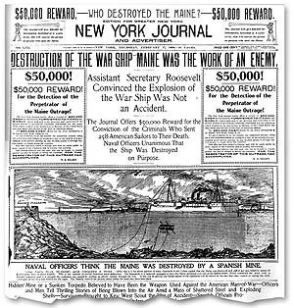
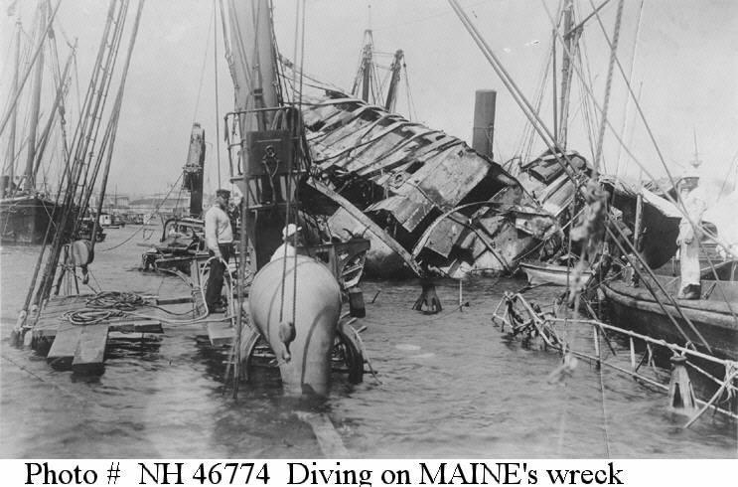

Slide 36
War is Declared
McKinley swayed to act by public opinion and his own party members (Teddy Roosevelt, Henry Cabot Lodge). By April 11, 1898 McKinley ask Congress for power to use armed forces in Cuba to protect American property and trade. April 20- Congress approved and declared Cuba independent, demanded withdrawal of Spanish troops.
Teller Amendment added by Senate. Said US had no intention to retain control over Cuba
McKinley signed and Spain sent a letter. April 22, McKinley announce blockade of Cuba= an act of war. Spain declared war on April 24th, but Congress wanted to be first to do this. US declared war on 25th, but made it retroactive to April 21, 1898.

Slide 37
War in the Philippines and in the Caribbean
Spain had Pacific colonies of Philippines and Guam, some outposts in Africa, and Puerto Rico. Roosevelt sent Commodore George Dewey to Manila Bay in Philippines.
April 30, U.S. Pacific fleet arrived and opened fire on Spanish warships. Within hours, Dewey and men captured or destroyed all Spanish warships. Filipinos (under Emilio Aguinaldo) on side of America to gain freedom from Spain. They joined with American forces against Spanish. August 13, Spanish troops surrendered to U.S.
In Caribbean- US sets up naval blockade of Cuba and traps Spanish fleet in harbor of Santiago de Cuba.
US Navy was very strong, but Army was not. Had a many inexperienced and ill-trained volunteer soldiers, lacked supplies, ineffective leaders.

Slide 38
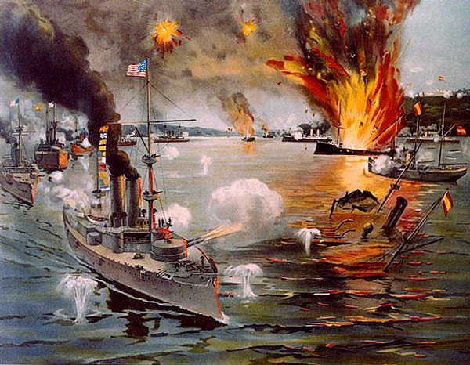

Slide 39
Teddy Roosevelt and the Rough Riders
US forces land in Cuba in June 1898- head to Santiago. Included African-American regiments (Buffalo Soldiers under “Blackjack” John Pershing) and former Asst. Sec. of Navy, Teddy Roosevelt. He was leading volunteer cavalry known as Rough Riders.
July 1: Hot air balloon used to scope out heights. Rough Riders (sans horses), white, and African-American Regiments charged up Kettle Hill. Faced heat exhaustion, continuous fire from Spanish, but finally clear the way and take over heights.
"...the entire command moved forward as coolly as though the buzzing of bullets was the humming of bees. White regiments, black regiments, regulars and Rough Riders, representing the young manhood of the North and the South, fought shoulder to shoulder, unmindful of race or color, unmindful of whether commanded by ex-Confederate or not, and mindful of only their common duty as Americans.” -Pershing

Slide 40
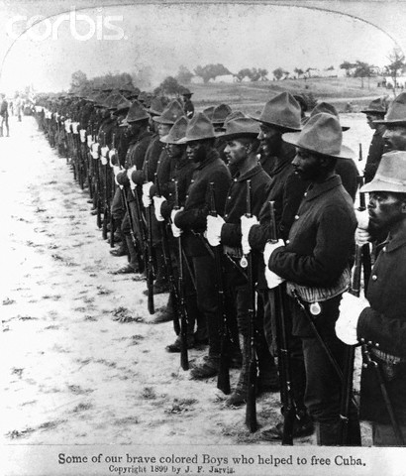

Slide 41
San Juan Hill
July 2: Soldiers and officers face rifle and artillery fire as wait for orders that Americans had captured San Juan and they could begin to take the heights.
Spanish forces were entrenched at top of the hill and held ability to fire directly on approaching Americans. American forces move up the hill, facing high casualties. Buffalo soldiers and white infantry units ascend. Roosevelt calls for his Rough Riders to leave Kettle Hill and assist, although fighting almost over. Despite this- TR and RRs get much fame from their role in taking the heights. Black effort nearly disappears into history.
July 4th- US naval fleet destroys Spanish fleet and later (July 25th) invades Spanish held Puerto Rico. Military rule for protection.

Slide 42
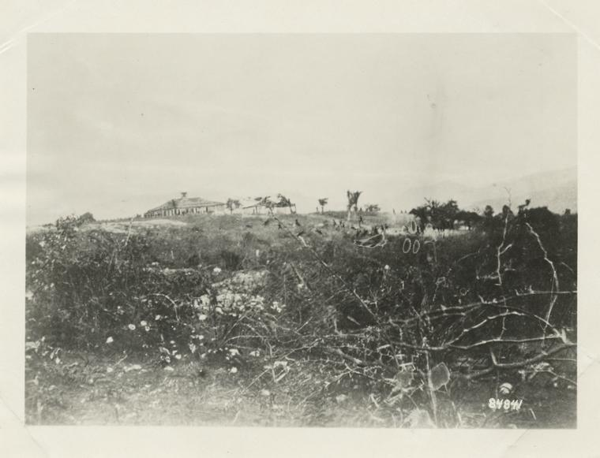
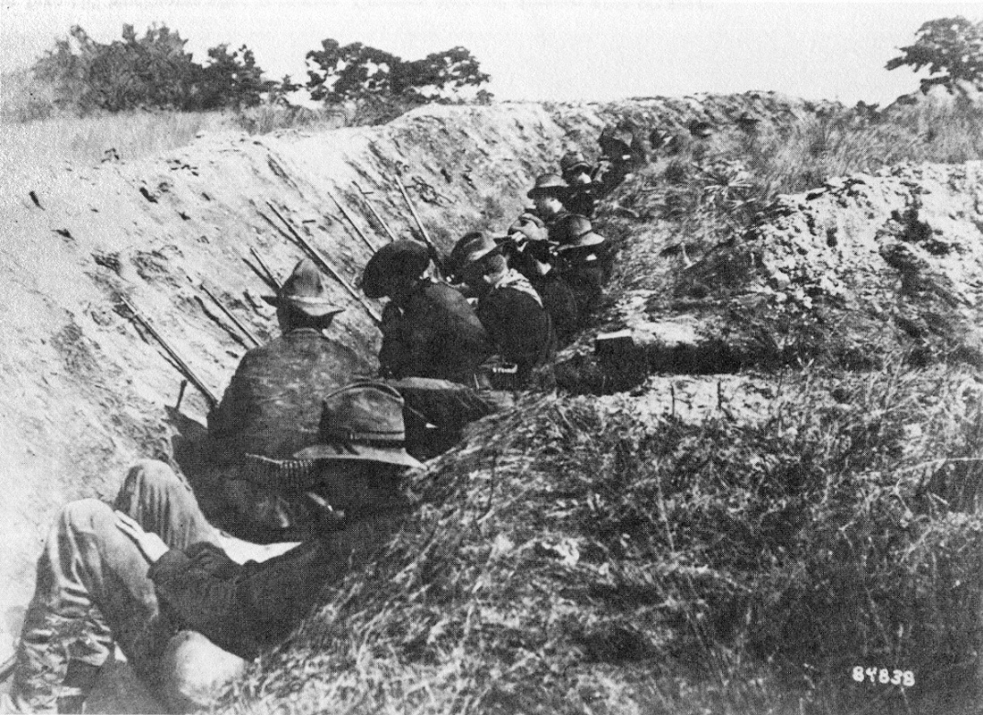

Slide 43
The Treaty of Paris
US and Spain signed an ARMISTICE (cease-fire) on August 12th. Ended the 15-week “splendid little war” (Sec. of State- John Hay).
Dec. 10, 1898- US and Spain met in Paris to agree on treaty. Spain freed Cuba, Guam and Puerto Rico turned over to US, and Philippines sold to US for $20 million. Feb. 6th, 1899- Senate approved treaty- an empire is born.

Slide 44
Ch. 10, Sec. 3: Acquiring new land
Puerto Rico, Cuba, Philippines, China

Slide 45
PUERTO RICO
PR acquired by U.S. in Treaty of Paris after the Spanish-American War.
During war, U.S. military occupied the island to bring protection to all people & property, to promote prosperity, & bestow blessings of U.S. government.
PR important for maintaining a U.S. presence in the Caribbean and to protect future canal in Panama. Foraker Act passed in 1900 to set up a civil government for PR.

Slide 46
Act ended military rule, gave president power to appoint Governor of PR, set up Legislature (upper house-Pres, lower house-vote of people).
1901- Supreme Court says Constitution does not apply to territories. Congress could extend U.S. citizenship, which it gave to PR in 1917 along with ability to elect both houses of legislature

Slide 47
CUBA
After Spanish-American war, U.S. troops still occupied Cuba.
Same government officials as under Spain, protestors imprisoned or exiled.
American military gov. provided food and clothing, helped farmers, founded schools, improved sanitation and medical research (eliminated yellow fever).
1900- new Cuban government set up and wrote constitution. 1901, U.S. Congress push for Cuba to adopt the Platt Amendment.
US had right to intervene in Cuba, US could buy/lease land for naval interests, no treaties allowed that limit independence or allow foreign power to control any part of territory, couldn’t go into debt.
U.S. would not withdraw army until Cuba accepted Platt Amendment. Many protestors who want to take up arms against Americans. Cubans finally agree in 1903- add to Constitution and stays in affect as a treaty until 1934.

Slide 48
Cuba became a U.S. protectorate- country whose affairs are partially controlled by a stronger power.
U.S. want to retain political presence in Cuba to protect U.S. investments and business interests.

Slide 49
PHILIPPINES
Filipinos initially on side of U.S. against Spanish control. Outraged after Treaty of Paris- feel betrayed (believed U.S. promised independence).
U.S. took over role of Spain- an imposing authority
Feb. 1899- Filipinos (Emilio Aguinaldo) rebel against U.S. and turn to guerrilla tactics.
U.S. force Filipinos into designated “zones” (poor sanitation, starvation, disease rampant).
White soldiers see Filipinos as inferior. Many black soldiers condemned by blacks in U.S. for spreading racial prejudice- some desert and aid Filipinos, many remain loyal and fight with U.S.

Slide 50
Rebellion ended in 1902. U.S. appoint Governor, legislature formed. Under American rule, Philippines gradually gain independence (July 4, 1946)

Slide 51
CHINA
European countries already present in Asia/China. U.S. saw Philippines as gateway into China: new markets for U.S. products, investment opportunities.
1899, Open Door notes issued by U.S. (John Hay, Sec. of State): letters to leaders of imperialist nations proposing that trading rights be shared w/ U.S. (creating an open door).
No national monopolies on trade w/ any part of China

Slide 52
Boxer Rebellion: China was free, but dominated by Europeans in cities. Boxers were group of Chinese that wanted to rid the country of “foreign devils.”
Killed many missionaries and other foreigners, Chinese converts to Christianity. Saw Western powers as a corrupt influence (government, religion, traditions, economy).
1900- British, French, German, Japanese, American troops. Within months, put down the Boxer Rebellion- many Chinese die in the fight.

Slide 53
After Boxer Rebellion, U.S. issue another series of Open Door notes to prevent European powers from claiming more control of China.
Keep safe the principle of equal and impartial trade

Slide 54
U.S. beliefs about industrial capitalist economy:
Growth of economy dependent on exports
The right to intervene to keep foreign markets open
Any area closed to U.S. products, citizens, ideas was a threat to U.S. survival
Anti-Imperialism in America: U.S. should not rule over other people without their consent
Mark Twain, Jane Addams, Grover Cleveland, Andrew Carnegie

Slide 55
Ch. 10, sec. 4: America as a world power
Foreign policy under Roosevelt and Wilson

Slide 56
Teddy Roosevelt as President
1901- Roosevelt became President when McKinley was assassination. Refused to let Europe control world’s political and economic destiny.
PEACEMAKER: Russo-Japanese war broke out in 1904 over control of Korea. Japanese destroyed Russian navy twice. As they run out of men/money, reach out to TR to negotiate peace talks with Russia. Met in Portsmouth, NH and Treaty of Portsmouth ended war. For his role, TR received Nobel Peace Prize in 1906.

Slide 57
PANAMA CANAL: Purpose to reduce travel time for commercial/military ships. 1903- U.S. purchase claim for $40 million to canal that was being built by the French (gave up after 10 years) through Panama.

Slide 58
Panama Canal
Before work could start, U.S. had to get permission from Colombia (owned Panama at time). Nov., 1903- Agent to U.S. (Philippe Bunau-Varilla) help organize Panamanian rebellion to overthrow Colombian rule. U.S. sends warships to back up rebels. 15 days later, U.S. and Panama sign treat for U.S. to pay lump sum ($10 mil.) and rent for “canal zone.”

Slide 59
Work started in 1904 and by 1913, had over 43,000 workers (Italy, Spain, blacks from West Indies). More than 5,000 died from disease or accident. Canal opened in 1914.
U.S. relations in Latin America had diminished because of support of rebellion in Panama. 1925- U.S. give Colombia $25 mil. To compensate for loss of territory.

Slide 60
Roosevelt’s Big Stick Policy
Roosevelt determined to make U.S. the predominant power in Caribbean and Central America. Reminded Europe about MONROE DOCTRINE (stay out!) and added ROOSEVELT COROLLARY- if any disorder in Latin America, U.S. would be forced to act as international police power.
“Speak softly and carry a big stick; you will go far.”

Slide 61
U.S. intervene several times. 1911- Nicaraguan rebellion leave nation near bankruptcy. U.S. banks loan money to Nicaragua and collect money back by taking in Nicaraguan custom duties, controlling banks and RRs.
Dollar Diplomacy= U.S. gov. guarantee loans to other countries by American businesspeople. Use to keep European powers out of Caribbean.

Slide 62
WOODROW WILSON
Woodrow Wilson becomes Pres. in 1913. Said U.S. had moral responsibility not to recognize governments in Latin America it viewed as oppressive, undemocratic, or hostile to U.S. interest.
Mexican Revolution: Porfirio Diaz had ruled over Mexico as military dictator for 30 years, but was friend of U.S. and encouraged foreign investment in Mex. Many oil wells, mines, RRs, ranches make U.S. businessmen, Mex. Politicians/landowners rich- common people live in extreme poverty.

Slide 63
1911- Mexican peasants/workers under Francisco Madero overthrew Diaz. General Victoriano Huerta took over in 1913 (Madero murdered shortly after). Wilson refuse to recognize government of “butchers.”
April 1914- American sailors arrested on east coast of Mexico. Wilson sends in Marines to invade & occupy Veracruz (port). Other countries come in to calm U.S. & Mexico, but goes nowhere. Only when Huerta regime collapse in 1915 does Wilson withdraw troops.

Slide 64
Rebellion in Mexico
1915- Venustiano Carranza became President, but did not have support of all Mexicans. Rebels under Pancho Villa and Emiliano Zapata seek reform. Both upset at U.S. for recognizing Carranza- murder Americans in Mexico, raid into New Mexico. Wilson sends John Pershing to catch Villa and sends troops to Mexican border. Frustrations rise between two countries. Feb. 1917- Wilson withdraw troops as he faced war in Europe.
Foreign Policy goals achieved by U.S.: 1. expanded access to foreign markets to grow economy, 2. build up navy to protect foreign interests, 3. Enforced international peace power to protect dominance in Latin America.

